Slide 1
Chapter 9 Crash Recovery
Presented by : Er. Lali Manandhar
Assistant Senior Lecturer
Everest Engineering College

Slide 2
Recovery System
A computer system is subjected to failure due to variety of causes such as disk crash, power failure, software crash, fire, network down etc.
Whatever the cause, information may be lost.
The database must take action in advance to ensure that atomicity and durability properties of transaction are preserved.
Recovery System in an integral part of a database system which is responsible for the restoration of the database to a consistent state that existed prior to the occurrence of the failure.

Slide 3
Failure Classification
Designing a reliable system that can recover form failure requires identifying the types of failure with which the system has to deal.
The major types of failures are:
Transaction failure: The transaction failure occurs when a transaction is aborted. There are two types of error that can make a transaction to fail.
Logical errors: transaction cannot complete due to some internal error condition such as bad input data, resource limit exceeds etc.
System errors: the database system must terminate an active transaction due to an error condition (e.g., deadlock). The transaction however can be re-executed at later time.

Slide 4
2. System crash:
a power failure or other hardware or software failure causes the system to crash.
This generally occurs when there is hardware malfunctioning, there is bug in the database software or OS resulting loss of content of volatile storage.
3. Disk failure:
a head crash or similar disk failure destroys all or part of disk storage.
Copies of data on another disk or ternary media such as tapes are used to recover from the failure.
4. Natural Disaster:
fire, flood, earthquake etc. may cause physical loss of all information on all media.

Slide 5
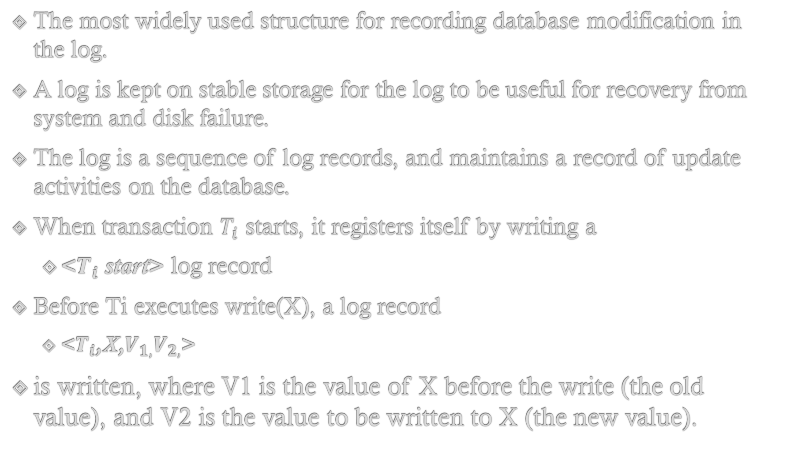
Log Based Recovery
The most widely used structure for recording database modification in the log.
A log is kept on stable storage for the log to be useful for recovery from system and disk failure.
The log is a sequence of log records, and maintains a record of update activities on the database.
When transaction $T_{i}$ starts, it registers itself by writing a
<$T_{i}$ start>log record
Before Ti executes write(X), a log record
<$T_{i}$,X,$V_{1,}V_{2,}$>
is written, where V1 is the value of X before the write (the old value), and V2 is the value to be written to X (the new value).

Slide 6
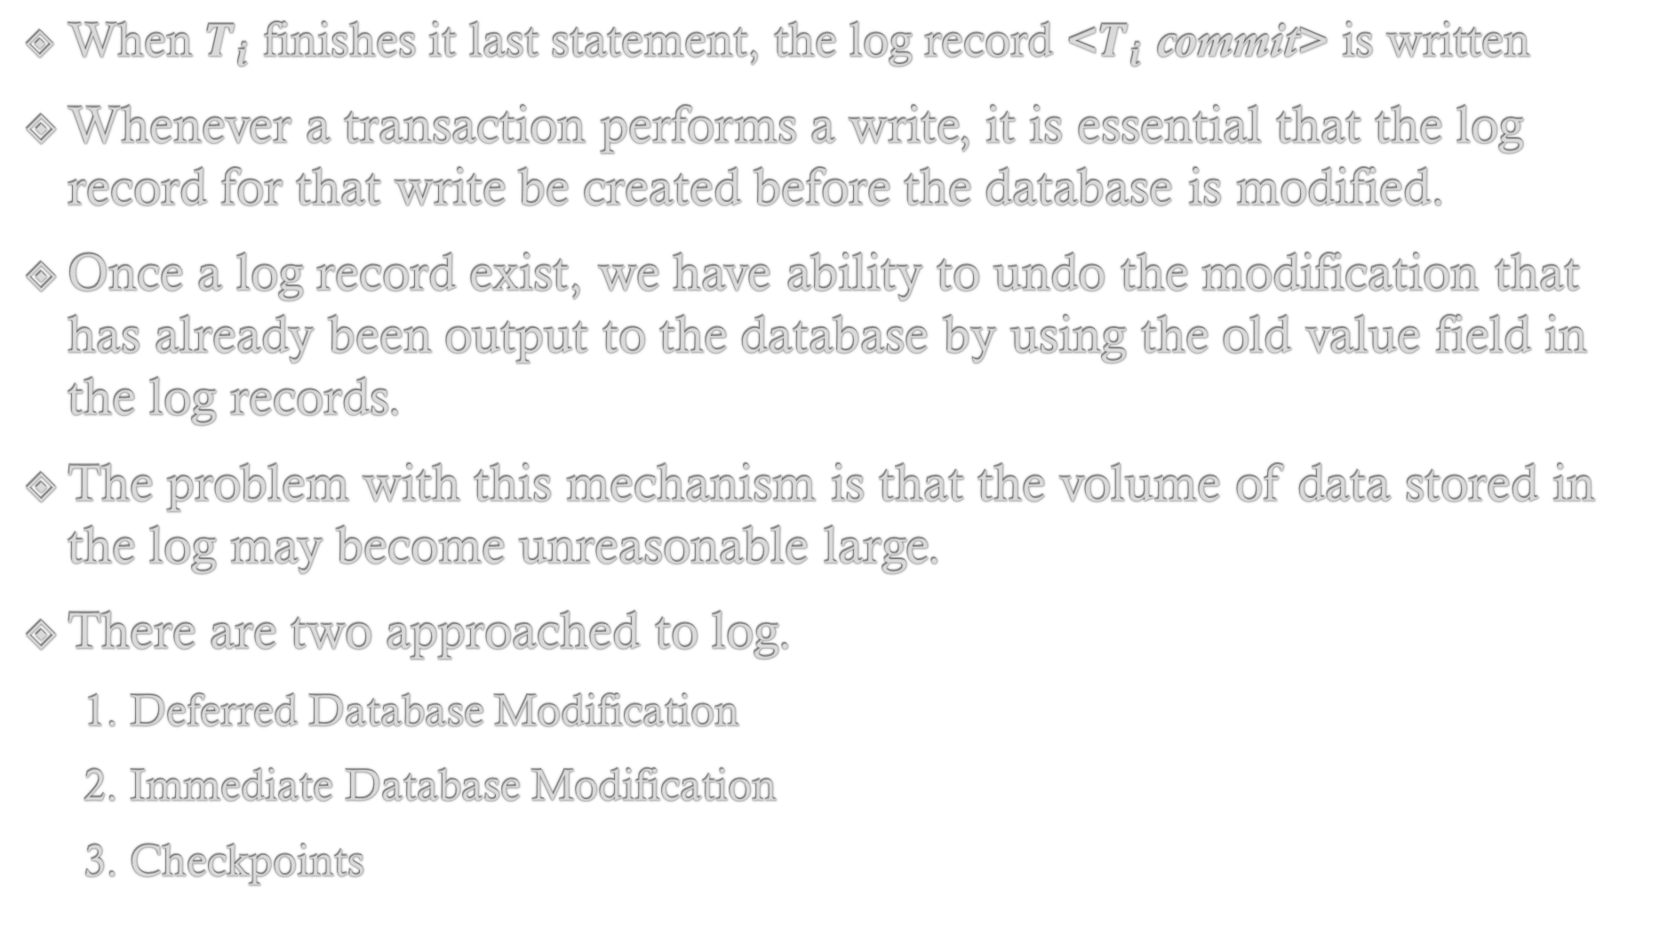
When $T_{i}$ finishes it last statement, the log record <$T_{i}$ commit>is written
Whenever a transaction performs a write, it is essential that the log record for that write be created before the database is modified.
Once a log record exist, we have ability to undo the modification that has already been output to the database by using the old value field in the log records.
The problem with this mechanism is that the volume of data stored in the log may become unreasonable large.
There are two approached to log.
1. Deferred Database Modification
2. Immediate Database Modification
3. Checkpoints

Slide 7
1. Deferred Database Modification
The deferred database modification scheme doesn’t physically update the database on disk until the transaction reaches its commit point.
Before reaching commit, all transaction updates are recorded in the transaction local workspace (buffer or main memory).
During commit, the updates are first recorded in log and then written to the database.
If the transaction fails before reaching its commit point, it will have made no changes to database in any way so no UNDO operation is necessary.
It may be necessary to REDO effect of the operations of commit transactions from the log because their effect may not have been recorded in the database.

Slide 8
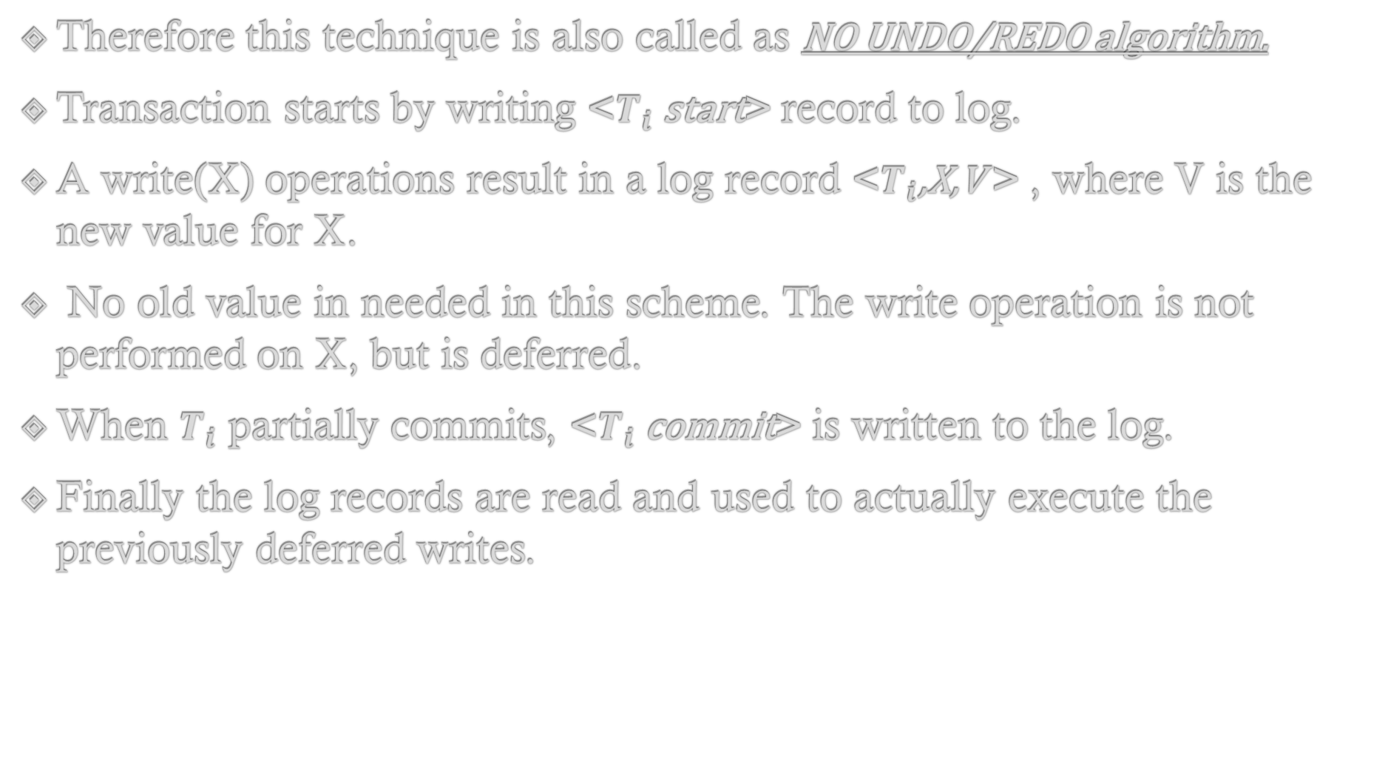
Therefore this technique is also called as NO UNDO/REDO algorithm.
Transaction starts by writing <$T_{i}$ start>record to log.
A write(X) operations result in a log record <$T_{i}$,X,V >, where V is the new value for X.
No old value in needed in this scheme. The write operation is not performed on X, but is deferred.
When $T_{i}$ partially commits, <$T_{i}$ commit>is written to the log.
Finally the log records are read and used to actually execute the previously deferred writes.

Slide 9
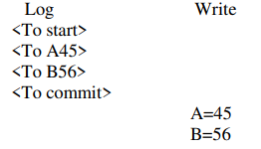
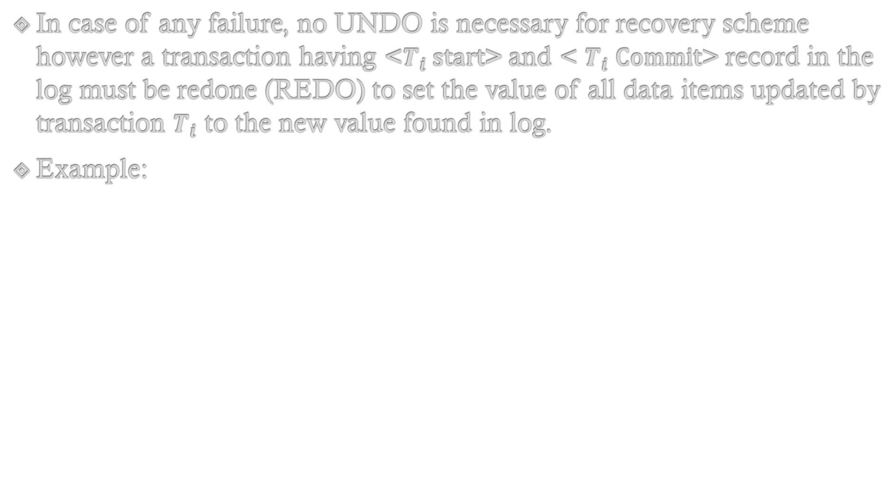
In case of any failure, no UNDO is necessary for recovery scheme however a transaction having <$T_{i}$ start>and <$T_{i}$ Commit> record in the log must be redone (REDO) to set the value of all data items updated by transaction $T_{i}$ to the new value found in log.
Example:

Slide 10
2. Immediate Database Modification (Uncommitted Modification)
In this technique, the database may be updated by some operation of transaction before the transaction reaches to its commit point.
However these operations are typically recorded in the log on the disk before they are applied to database, making recovery still possible.
If the transaction fails after recording some changes in the database but before reaching its commit point, the effect of its operation must be undone (UNDO) i.e. the transaction must be Rolled Back.
So immediate update requires both UNDO and REDO during recovery.
Therefore it is also known as UNDO / REDO algorithm.

Slide 11
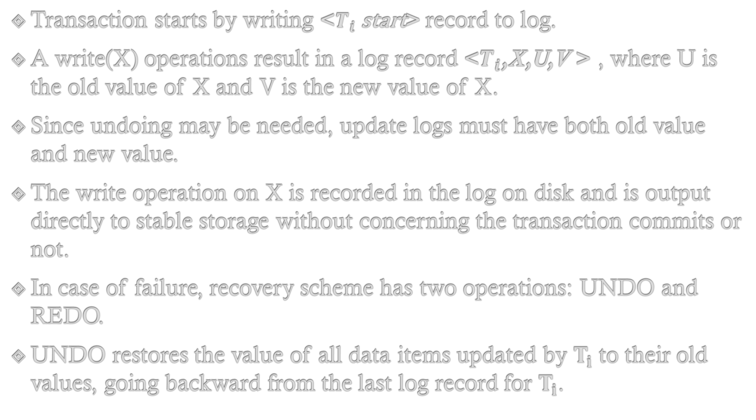
Transaction starts by writing <$T_{i}$ start>record to log.
A write(X) operations result in a log record <$T_{i}$,X,U,V >, where U is the old value of X and V is the new value of X.
Since undoing may be needed, update logs must have both old value and new value.
The write operation on X is recorded in the log on disk and is output directly to stable storage without concerning the transaction commits or not.
In case of failure, recovery scheme has two operations: UNDO and REDO.
UNDO restores the value of all data items updated by $T_{i}$ to their old values, going backward from the last log record for $T_{i}$.

Slide 12
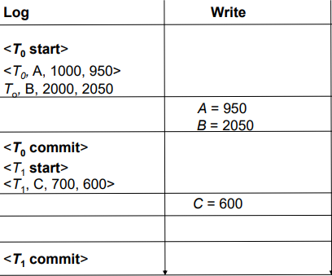
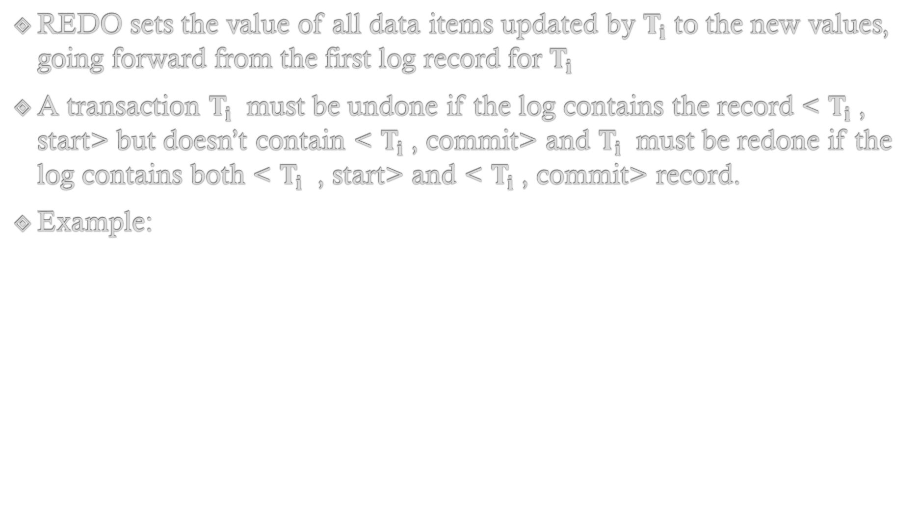
REDO sets the value of all data items updated by $T_{i}$ to the new values, going forward from the first log record for $T_{i}$
A transaction $T_{i}$ must be undone if the log contains the record <$T_{i}$, start> but doesn’t contain <$T_{i}$, commit> and $T_{i}$ must be redone if the log contains both <$T_{i}$ , start> and <$T_{i}$, commit> record.
Example:

Slide 13
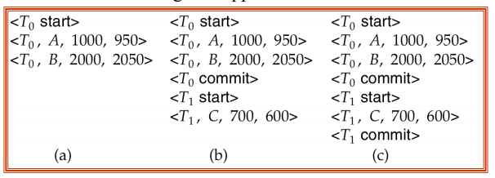
Another Example:
Recovery actions in each case above are:
(a) undo (T0): B is restored to 2000 and A to 1000.
(b) undo (T1) and redo (T0): C is restored to 700, and then A and Bare set to 950 and 2050 respectively.
(c) redo (T0) and redo (T1): A and B are set to 950 and 2050 respectively. Then C is set to 600

Slide 14
3. Checkpoints
The main problems faced in recovery procedure discussed earlier are
1. Searching the entire log to determine which transaction need to be redone and those that need to be undone is time consuming.
2. We might unnecessarily redo transactions which have already output their updates to the database.
A scheme called check point is used to limit the volume of log information that has to be handled and processed in the events of system failure.
A check point performs periodic copy of log information onto the stable storage. A check point requires the following sequence of actions to take place.

Slide 15
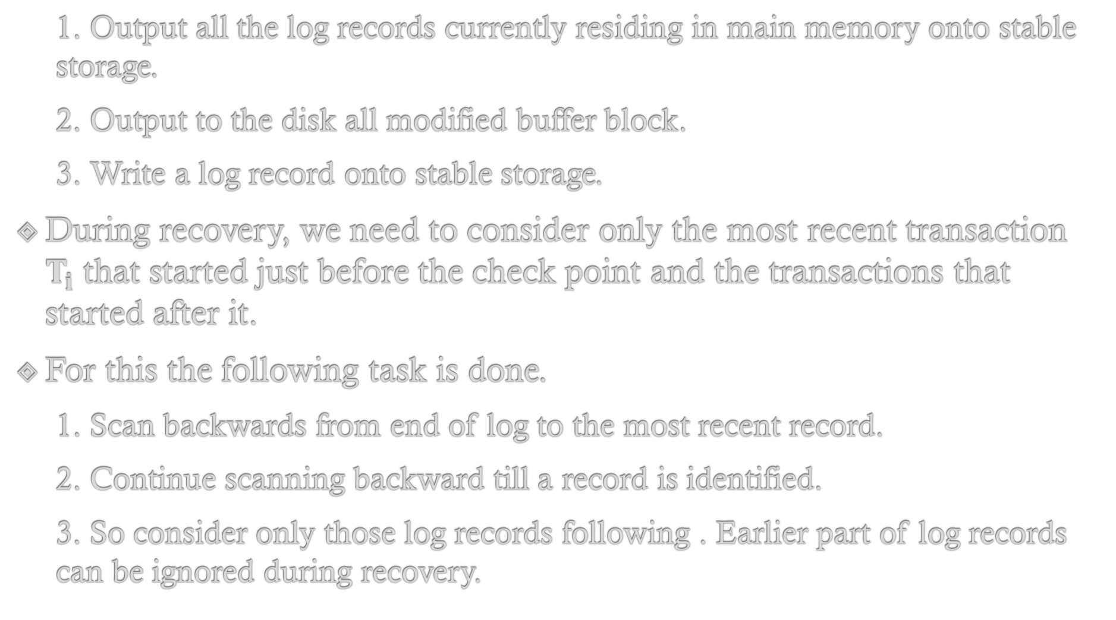
1. Output all the log records currently residing in main memory onto stable storage.
2. Output to the disk all modified buffer block.
3. Write a log record onto stable storage.
During recovery, we need to consider only the most recent transaction $T_{i}$ that started just before the check point and the transactions that started after it.
For this the following task is done.
1. Scan backwards from end of log to the most recent record.
2. Continue scanning backward till a record is identified.
3. So consider only those log records following . Earlier part of log records can be ignored during recovery.

Slide 16
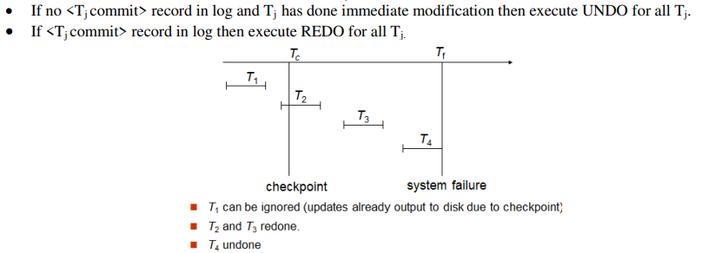
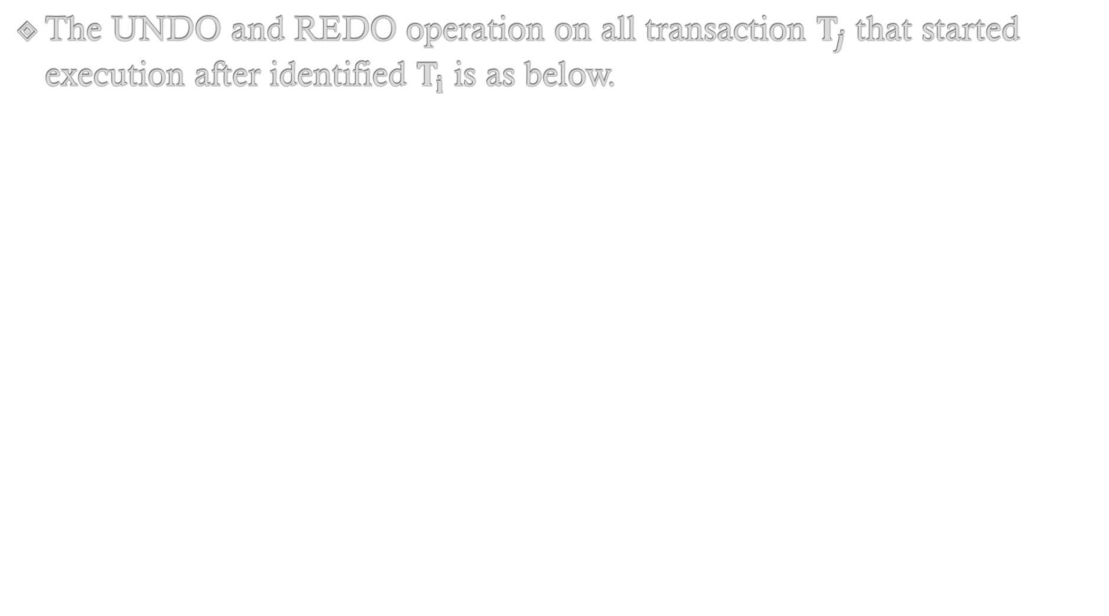
The UNDO and REDO operation on all transaction $T_{j}$ that started execution after identified $T_{i}$ is as below.

Slide 17
Shadow Paging
Shadow paging is an alternative to log based recovery which is useful if transaction executes serially.
Here, when a page of storage is modified by a transaction, a new page is allocated for the modified data and the old page remains as a shadow copy of the data.
In this technique, database is partitioned into some number of fixed length block called as pages.
The key idea behind shadow paging technique is to maintain two page tables during the lifetime of a transaction.
These tables are called as current page table and shadow page table.

Slide 18
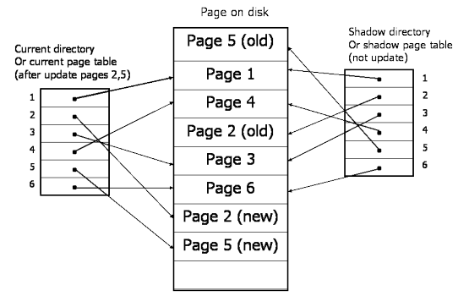
Each entry in the page tables contain pointer to a page on a disk.
When the transaction starts, both tables are identical.
The shadow page table is never changed during the life of the transaction.
The current page table is updated with each write operation.

Slide 19
Whenever any page is to be written for the first time
A copy of this page is made onto an unused space.
The current page table is then made to point to the copy.
The update is performed on the copy
The transaction commits after performing the following steps
Flush all modified pages in main memory to disk.
Output current page table to disk.
Make the current page table the new shadow page table by simply updating the pointer to point current page table in disk.

Slide 20
To recover from a failure during transaction execution, it is sufficient to free the modified database pages and to discard the current page table.
The state of the database before transaction execution is available through the shadow page table, and that state is recovered by reinstating the shadow page table.
The database thus is returned to its state prior to the transaction that was executing when the crash occurred, and any modified pages are discarded.
Committing a transaction corresponds to discarding the previous shadow page table.
Since recovery involves neither undoing nor redoing data items, this technique can be categorized as a NO-UNDO/NO-REDO technique for recovery.

Slide 21
Advantage
No overhead of writing log records.
Recovery is simple.
No Undo / No Redo algorithm.
Disadvantage
Copying the entire page table is very expensive
Commit overhead: The commit of a single transaction requires multiple blocks to be output: the current page table, the actual data i.e. updated pages. Log based scheme need to output only the log records.
Data fragmentation: It causes database pages to change location making no longer contiguous.

Slide 22
4. Garbage collection: Each time a transaction commits, the database pages containing the old version of data changed by the transaction must become inaccessible. Such pages do not contain usable information hence considered as garbage. Periodically it is necessary to find all the garbage pages and add them to the list of free pages. The process is called garbage collection and requires additional overhead and complexity on the system.
5. Hard to extend algorithm to allow transaction to run concurrently

Slide 23
Backup vs. Recovery
In a nutshell, the primary difference between backup and recovery is that the former is a copy of original data that can be used in case of a database failure while recovery refers to the process of restoring your database to its correct (original) state when a failure occurs.
As stated earlier, backup refers to a representative copy of data and includes essential elements of a database such as data files and control files. Since unexpected database failures are inevitable, a backup of the entire database is required.
There are two major backup types:
1. Physical Backup: This is a copy of physical database files such as data, control files, log files, and archived redo logs that store database information in another location and forms the foundation of the database recovery mechanism.

Slide 24
2. Logical Backup: It contains the logical data that is extracted from a database, and it consists of tables, procedures, views, functions, etc.
Recovery, on the other hand, helps you to restore your database to its correct state in the event a failure occurs. It improves the reliability of your database since it allows the database to recover to a consistent state after sudden failure.
It is entirely possible to recover your database using log-based recovery.
The log of all your transactions when stored in a stable storage helps you to recover your database after failure.
It contains information about transactions to execute, transaction states, and modified values.

Slide 25
Remote Backup System
Traditional transaction-processing systems are centralized or client–server systems.
Such systems are vulnerable to environmental disaster such as fire, flooding, or earthquakes.
Increasingly, there is a need for transaction-processing systems that can function in spite of system failures or environmental disasters.
Such systems must provide high availability; that is, the time for which the system is unusable must be extremely small.
We can achieve high availability by performing transaction processing at one site, called the primary site, and having a remote backup site where all the data from the primary site are replicated.
The remote backup site is sometimes also called the secondary site.

Slide 26
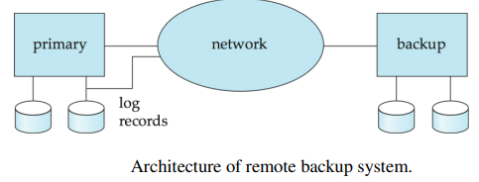
The remote site must be kept synchronized with the primary site, as updates are performed at the primary.
We achieve synchronization by sending all log records from primary site to the remote backup site.
The remote backup site must be physically separated from the primary—for example, we can locate it in a different state—so that a disaster at the primary does not damage the remote backup site.

Slide 27
When the primary site fails, the remote backup site takes over processing.
First, however, it performs recovery, using its (perhaps outdated) copy of the data from the primary, and the log records received from the primary.
In effect, the remote backup site is performing recovery actions that would have been performed at the primary site when the latter recovered.
Once recovery has been performed, the remote backup site starts processing transactions.
When the backup site takes over processing it becomes the new primary and the old primary site become new backup site.

Slide 28
RAID (LEVEL 0-6) Redundant Array of Independent Disk

